Slide 1
EARLY WARNING FOR PRE AND POST FLOOD RISK MANAGEMENT
2021-124

Slide 2
Introduction

Slide 3
Overall Project Description
Flooding and landslides have been a very treacherous situation in Sri Lanka where many areas are flooded for the slightest rain.
Flooding happens due to various reasons such as human and natural reasons.
Comprehensive analysis on utilizing IOT devices for weather prediction
Analyze 3rd party API solutions which provides and real-time weather information and develop Proof-of-Concept to verify the accuracy of weather information.
Usage of data Mining algorithm for the weather prediction based on historic data analysis.
The implementation of the solution will comply of a web application and mobile application will visualize the finalized data for the end users based on their needs

Slide 4
Research Problem
Unavailability of an early warning tool will be very costly for most of the countries
One of the major problems that countries face when a flooding situation takes place is, loss of human lives, property losses, agricultural losses, and economic losses.
Due unadvanced system, poor coordination between people and the officials increase the flood disaster loses and recovery plans are delayed.
To address these situations, we propose to develop an early warning structure to minimize the devastating destruction that could be caused.

Slide 5
Objectives
Main Objective
Provide an early warning mechanism and predict severe weather conditions which may cause flooding with the use of real-time and historical data.
Sub Objectives
Provide near real-time data collected from IoT devices feeds.
Develop severe rainfall prediction model based on historic data analysis and provide suggestions to the end users.
Develop crowdsourcing solution to gather weather information from public crowd, analyze and present them to the end users.
Create the Flood Forecasting Model to predict the flooding for the selected specific area using historic data collected from past years.

Slide 6
Overall System Diagram

Slide 7
Research Paper Acceptance
ICAC - International Conference on Advancements in Computing - 2021 Conference (SLIIT)
ICITR - International Conference on Information Technology Research - 2021 (Moratuwa University)
Notes:
The Research Paper has Submitted
ICAC
ICITR (Moratuwa)

Slide 8
Commercialization
Use for weather information application.
Weather predictions for farmers near river basin.
Weather predictions for residents living near river basin.
First Responders in disaster management.
Government authorities.

Slide 9
IT18022902 | Ilukkumbure S. P. M. K. W
Information Technology
IT18022902 | Ilukkumbure S. P. M. K. W. | 2021-124

Slide 10
Introduction

Slide 11
Research Question
Can residents in that area get informed as soon as possible before a heavy rainfall result it to flooding.
Use of Data Driven Hydrological Models
Compared with hydrological models, data-driven models can obtain better or comparable forecasting results [3].
IT18022902 | Ilukkumbure S. P. M. K. W. | 2021-124

Slide 12
Challenges
Forecasting Shorter Times
Urban Areas
Forecasting Longer Times
Forecasting near river basin areas.
Low Levels of accuracy
Low Levels of performance
IT18022902 | Ilukkumbure S. P. M. K. W. | 2021-124

Slide 13
Objectives
Specific Objective
Create the Flood Forecasting Model to predict the flooding for the selected specific area using historic data collected about past 3 years.
Sub objectives
Analysis on river basin flooding data-driven model.
Provide method to overcome challenge of low performance and low accuracy.
IT18022902 | Ilukkumbure S. P. M. K. W. | 2021-124

Slide 14
Model Design
IT18022902 | Ilukkumbure S. P. M. K. W. | 2021-124

Slide 15
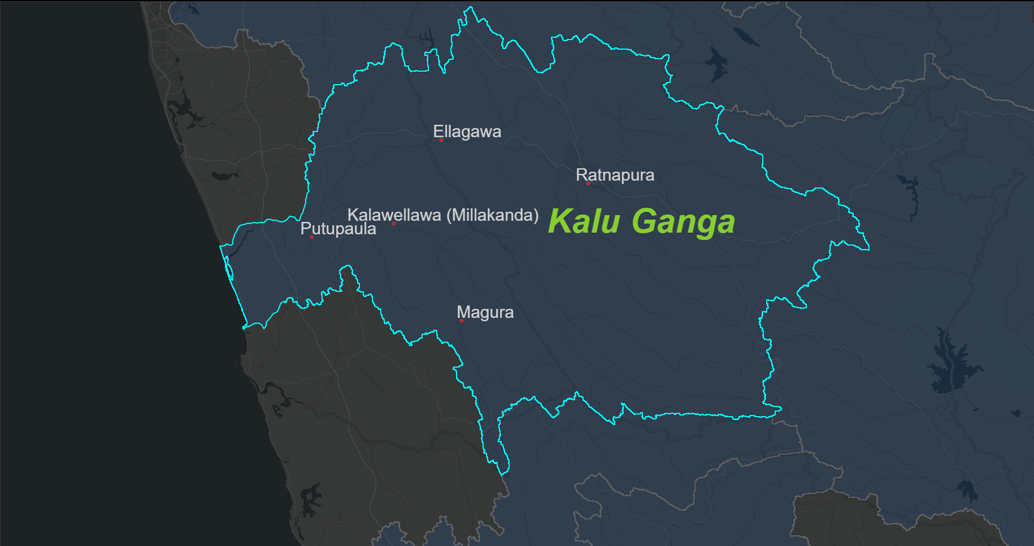
Study Area in Research
Kalu River Basin
Ellagawa
Kalawellawa (Millakanda)
Magura
Putupaula
Ratnapura
Why?
Suitable for Poof-Of-Concept
Urban Areas
Riverside Areas
Availability of Riverside data
IT18022902 | Ilukkumbure S. P. M. K. W. | 2021-124

Slide 16
Methodology
Data-mining \ Gathering
Water levels from Irrigation Department.
Daily levels Database
Data Reports from DMC (Disaster Management Centre).
Daily Reports Database
Representation
Dashboards

Slide 17
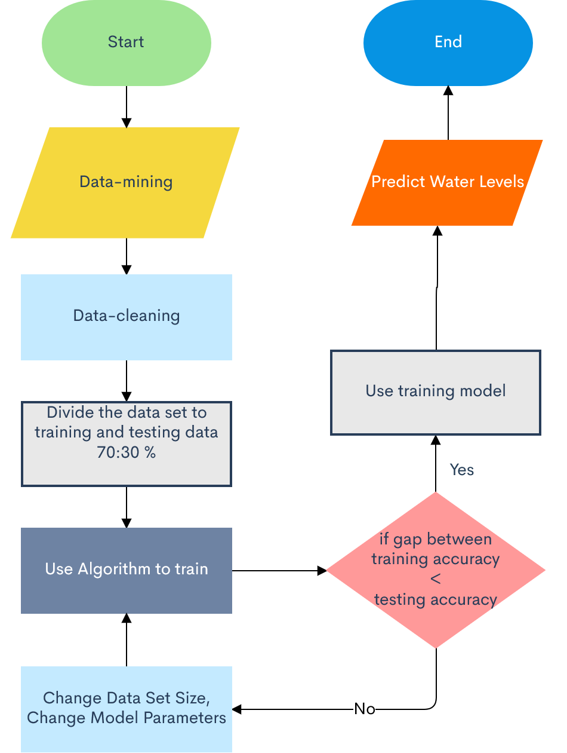
Water Model Flowchart
Change Batch Size
Increased from 50 to 100
Change Model Parameters
Use Normalized training set
Use Normalized test set

Slide 18
Data used
Water Levels of change in river on time basis
Number of water levels in a specific station.
Real-time Water levels
Rainfall model prediction’s data
This Photo by Unknown Author is licensed under CC BY-SA

Slide 19
Decision Making Model
With Summarized Data
Big Data
Summarized Data
Classified Judgement (Human)
Final Decision (Ai)

Slide 20
Decision-making Model
Water Model Classification
IoT Sensory Data Classification
Final Decision
Crowdsourcing Classification

Slide 21
Progress Completion
Obtained detailed data of daily water levels from Irrigation . Department.(2020-2021).
Processed and cleaned data of the obtain data.
Training the flood forecasting model with river level data.
Built Dashboard to represent Daily Water Level.
Build the decision-making model.
Test Models
Update the Web Dashboard to Represent Decision Making Model Predictions.

Slide 22
Techniques and Technologies
Machine Learning Frameworks
Scikit Learning
Keras
Programming Language
Python
Other Frameworks
Flask
Integrated Development Environment (IDE)
PyCharm
Jupyter notebook
Database
Firebase

Slide 23
Commercialization of Models API
Subscription (monthly/ annually) based API access for forecasts.
One-time payment API access for forecast in IoT device purchase

Slide 24
Demo

Slide 25
References
[1] M. Campolo, P. Andreussi, and A. Soldati, “River flood forecasting with a neural network model,” Water Resources Research, vol. 35, no. 4, pp. 1191–1197, 1999, doi: 10.1029/1998WR900086.
[2] S. Kokularamanan, A. W. M. Rasmy, D. Perera, and T. Koike, “Development of a Flood Forecasting and Data Dissemination System for Kalu River Basin in Sri Lanka,” Annual Sessions of IESL, The Institution of Engineers, Sri Lanka, vol. 1, pp. 205–210, 2017.
[3] A. Mosavi, P. Ozturk, and K. W. Chau, “Flood prediction using machine learning models: Literature review,” Water (Switzerland), vol. 10, no. 11, pp. 1–40, 2018, doi: 10.3390/w10111536.
[4] B. Li et al., “On the operational flood forecasting practices using low-quality data input of a distributed hydrological model,” Sustainability (Switzerland), vol. 12, no. 19, 2020, doi: 10.3390/su12198268.
[5] S. Puttinaovarat and P. Horkaew, “Flood Forecasting System Based on Integrated Big and Crowdsource Data by Using Machine Learning Techniques,” IEEE Access, vol. 8, pp. 5885–5905, 2020, doi: 10.1109/ACCESS.2019.2963819.
[6] S. N. Yang and L. C. Chang, “Regional inundation forecasting using machine learning techniques with the internet of things,” Water (Switzerland), vol. 12, no. 6, 2020, doi: 10.3390/W12061578.
[7] R. J. Moore, V. A. Bell, and D. A. Jones, “Forecasting for flood warning,” Comptes Rendus - Geoscience, vol. 337, no. 1–2, pp. 203–217, 2005, doi: 10.1016/j.crte.2004.10.017.
[8] H. Thilakarathne and K. Premachandra, "Predicting Floods in North Central Province of Sri Lanka using Machine Learning and Data Mining Methods," Research, 2017.

Slide 26
IT18003406 | MOHAMED M. F.
Information Technology

Slide 27
INTRODUCTION
IT18003406 M. F. Mohamed 2021-124

Slide 28
Research Problem
Monitoring weather data
Transmission live of weather data
All users not able to access the applications.
Providing weather data for users who could not access the system.
We will be focusing on a comprehensive solution to overcome such issues.
IT18003406 M. F. Mohamed 2021-124

Slide 29
Objectives
Specific Objective
Implementation of smart weather monitoring device which will transmit information to the application and implementation of a method to cater to the users who could not use our system.
Sub objectives
Implementing a smart weather monitoring device to monitor weather factors.
Successfully transmit information from the IoT device to the application without any commotions.
SMS based weather information providing for non subscribed users.
IT18003406 M. F. Mohamed 2021-124

Slide 30
RESEARCH METHODOLOGY
IT18003406 M. F. Mohamed 2021-124

Slide 31
Technologies and Techniques
IOT technologies
IOT devices and sensors
IOT development platform(Arduino IDE)
Connectivity
(Wi-Fi)
Firebase
Optimal data capturing and processing techniques
Java, C++
IT18003406 M. F. Mohamed 2021-124

Slide 32
Methodology
The IoT Device perspective will be consisting of 2 major parts
Implementation a smart weather monitoring device.
Non-Subscribed users to be able to receive weather data information.
1. Implementation a smart weather monitoring device
Weather monitoring is done with the help of IoT sensors.
Gathered weather data will be transmitted to the DB with the help of an ESP32 module.
These transmitted data will be previewed on the mobile application IoT data dashboard.
IT18003406 M. F. Mohamed 2021-124

Slide 33
Methodology
2. Non-Subscribed users to be able to receive weather data information.
Users could receive weather information despite of access to the applications.
User will receive weather information upon request only.
User needs to request information based on the location.
User needs to request via SMS by stating the location and will receive the update via same mode.
IT18003406 M. F. Mohamed 2021-124

Slide 34
Device Functionality Flow
IT18003406 M. F. Mohamed 2021-124

Slide 35
Completion
Designing a PCB for the IoT device to increase the productivity and the performance of it.
Assembling of the IOT device with all relevant modules(Sensors, microcontroller).
Successfully established the IOT device and the Database connection successfully.
Successfully preview the IOT device data on the mobile application dashboard.
Completed the SMS based weather data providing methodology.
IT18003406 M. F. Mohamed 2021-124

Slide 36
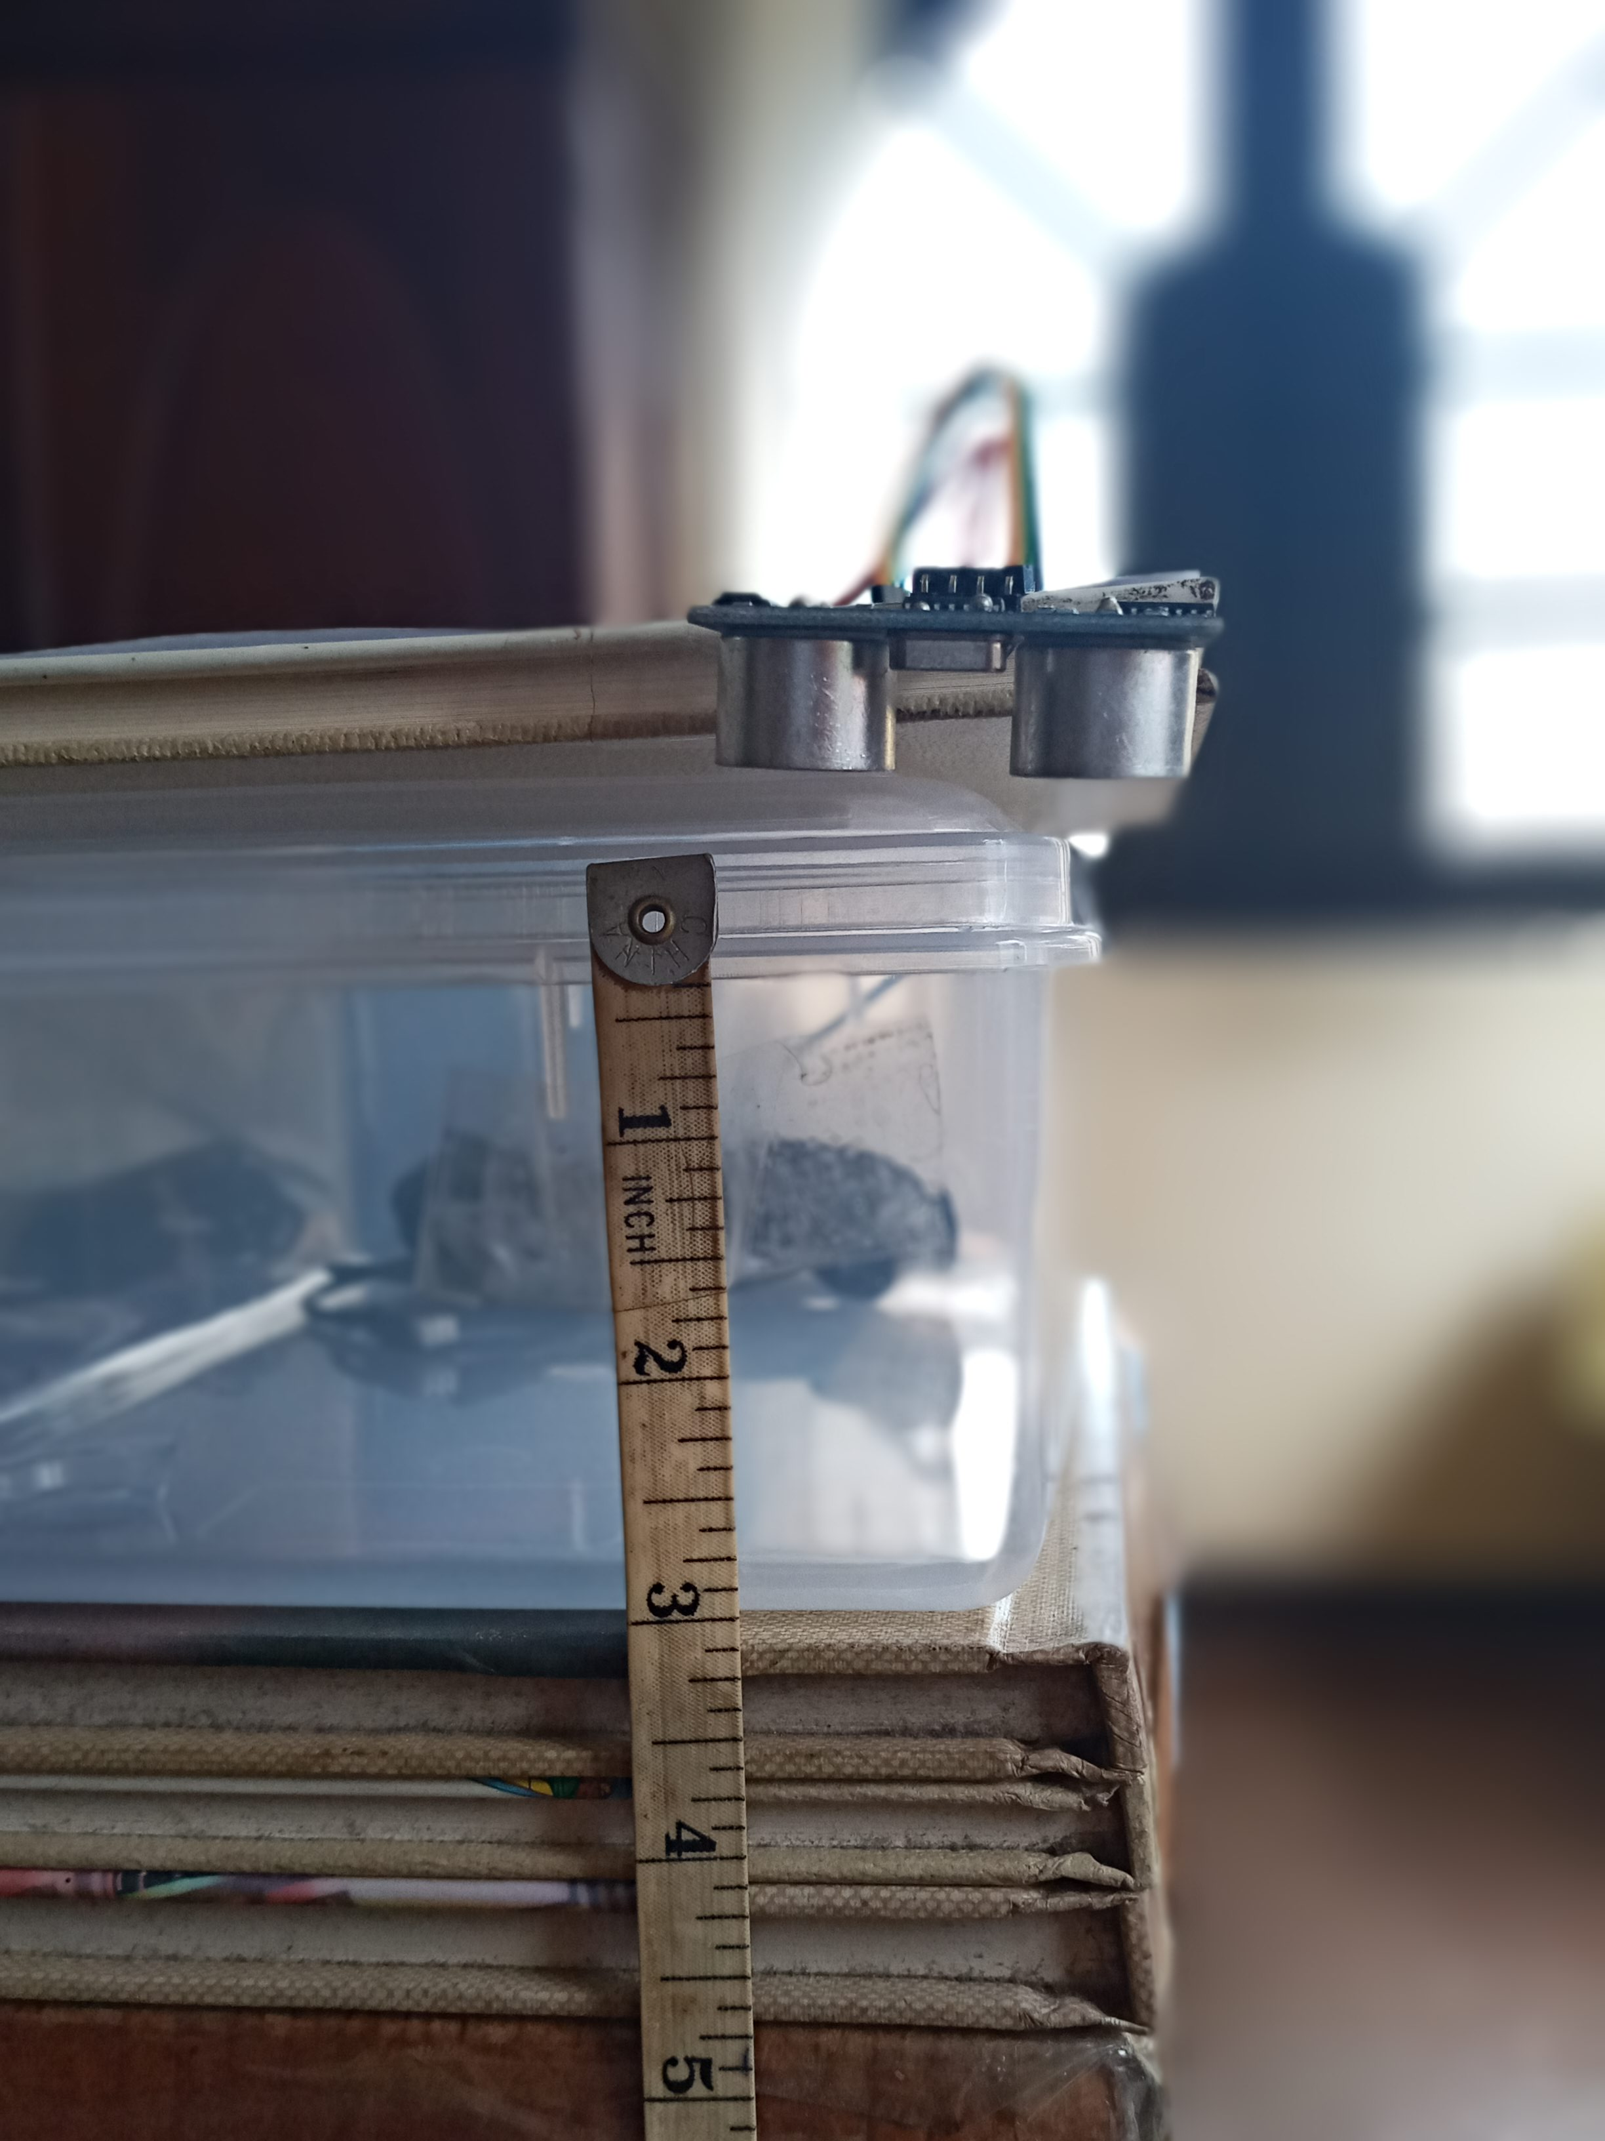
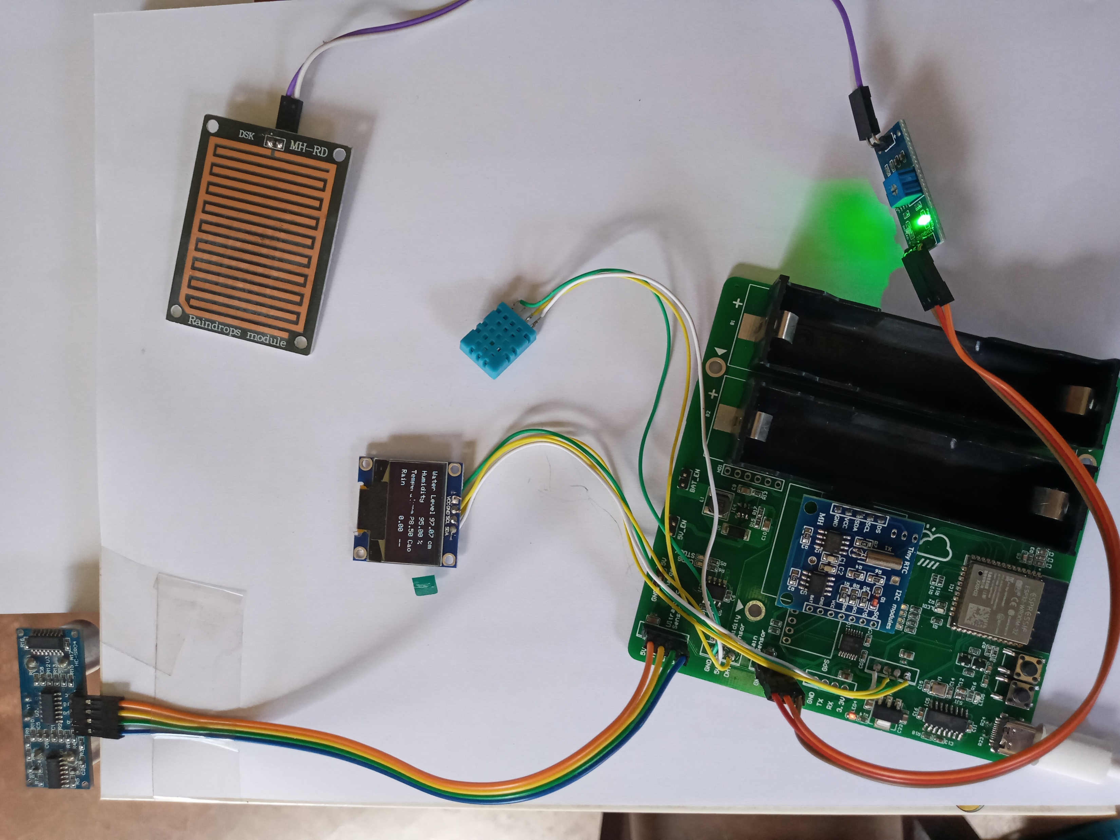
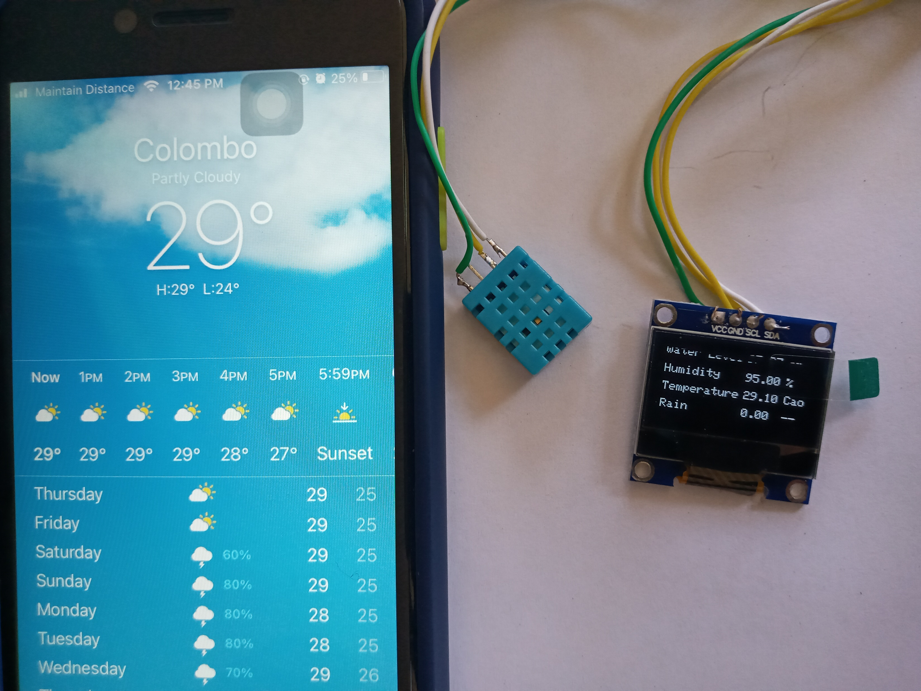
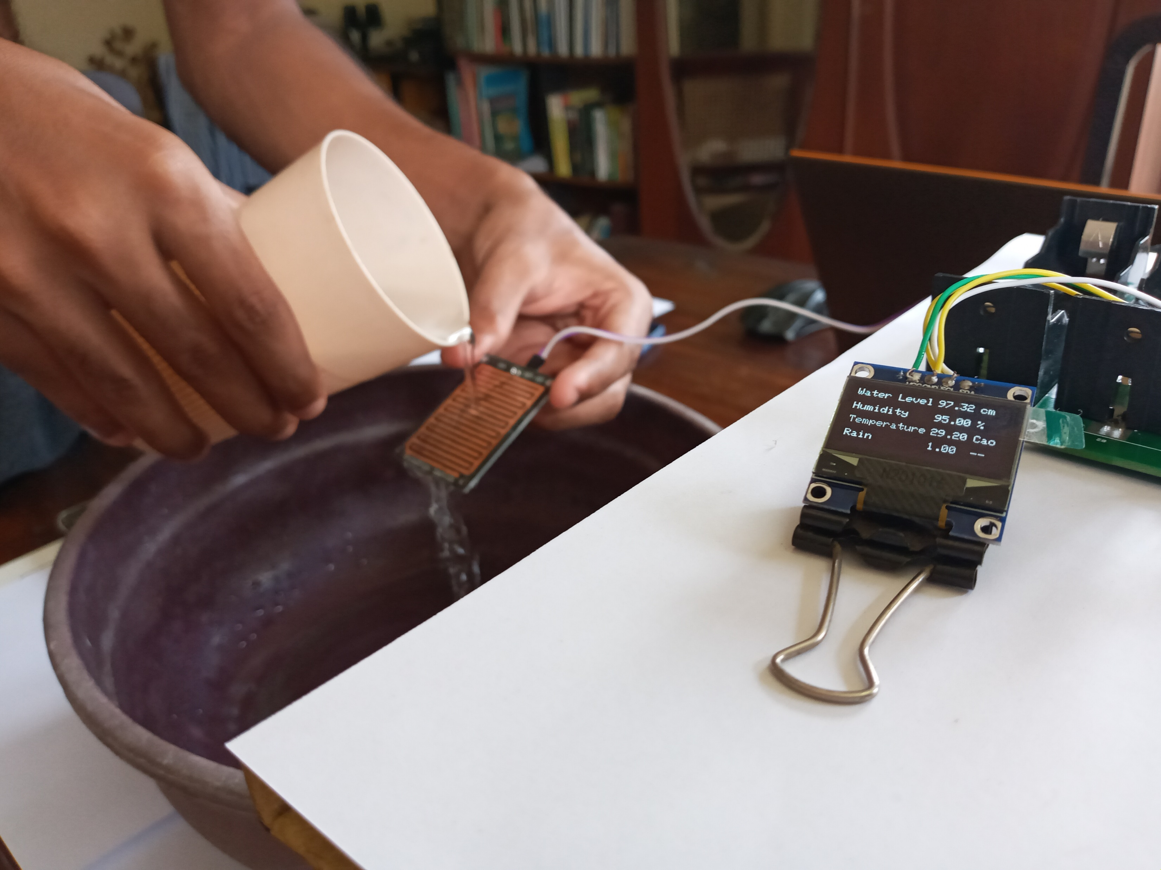
Images of the IoT Device
IT18003406 M. F. Mohamed 2021-124

Slide 37
Commercialization
Contract with external parties to transmit live data to there own Databases.
Contract with the state authorities which they could purchase this device for there day to day needs.
IT18003406 M. F. Mohamed 2021-124

Slide 38
IT18012620 | V.Y SAMARASIRI
Information Technology

Slide 39
INTRODUCTION
IT18012620 V.Y Samarasiri 2021-124

Slide 40
Research Problem
Usually, the input source of data for a crowdsourcing solution gathered from the public crowd.
Identified challenges
Sourcing the right crowd
Validate the accuracy of data (Data integrity)
Receive data in precise and concise format
Periodically receive live data
During this research, the primary focus is to design a comprehensive solution.
IT18012620 V.Y Samarasiri 2021-124

Slide 41
Objectives
Specific Objective
Main objective is to collect weather information from public crowd, analyze and validate gathered information using statistical data analysis techniques
Sub objectives
Implement a way to source the right crowd
validate the accuracy of crowd sourcing data (Data integrity)
Structure the data in precise and concise format
periodically receive live data
IT18012620 V.Y Samarasiri 2021-124

Slide 42
RESEARCH METHODOLOGY
IT18012620 V.Y Samarasiri 2021-124

Slide 43
High-Level Component Diagram
IT18012620 V.Y Samarasiri 2021-124

Slide 44
Methodology
The Crowdsourcing solution is divided into two main parts
1. Gather weather information from the crowd
2. Display crowdsourcing data to the users
1. Gather weather information from the crowd
Information gathered through set of questionaries
User interface for answering questionaries
User should be able to easily provide near accurate information
Impacted location is automatically captured through Mobile location feature
IT18012620 V.Y Samarasiri 2021-124

Slide 45
Methodology
2. Display crowdsourcing data to the users
Current location of the user who views data should automatically captured
If user needs, he should be able to change the location
Captured/selected location specific crowd sourcing information can be visualized
Crowdsourcing data manipualtion follows sequence of processings
IT18012620 V.Y Samarasiri 2021-124

Slide 46
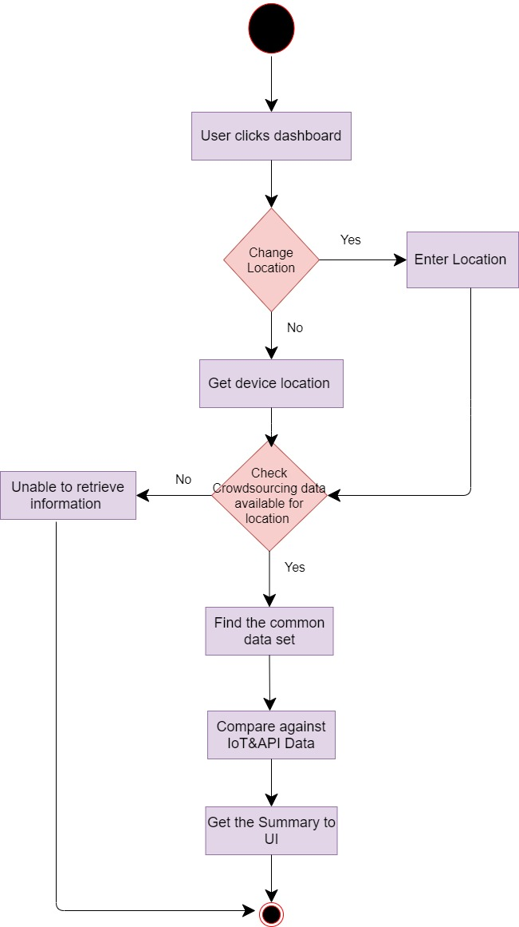
Data Manipulation Flow

Slide 47
Achievement
Successfully implemented mobile user registration
Establishing connection to the open weather map API using unique API key
Successfully retrieved live weather data from Open Weather Map API
Finalized the crowdsourcing data
Implemented the crowdsourcing UI
Retrieve crowdsourcing weather data from DB and find the common data set and validate the data set against IOT data & weather API data
Finally visualize the summary to main dashboard
IT18012620 V.Y Samarasiri 2021-124

Slide 48
Tools and Technologies
Android studio
Java
Java Script
Firebase
OpenWeatherMap API
IT18012620 V.Y Samarasiri 2021-124

Slide 49
Commercialization
Contracting with relevant state authorities
The application is sold to the state authorities

Slide 50
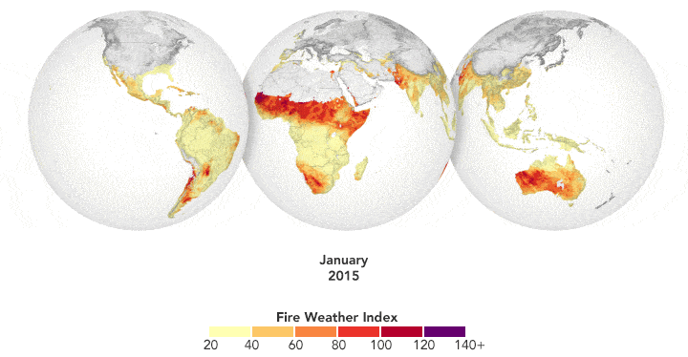
Information Technology
IT17181648 | Vinobaji S.

Slide 51
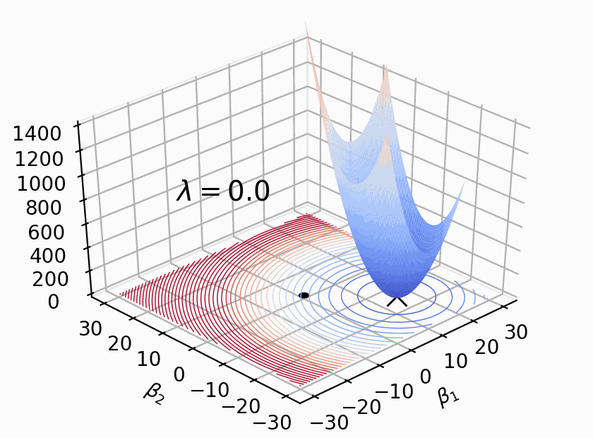
Introduction
Rainfall prediction is the one of the most common prediction in metrology.
There are many methods used to predict rainfall.
Using machine learning is also one of the methods to predict rainfall.
There are a lot of algorithms that can be used to predict rainfall in machine learning.

Slide 52
Background Study

Slide 53
Research
Gap
Exiting projects
Machine Learning models and algorithms-based approach.
Proposed Research
Attributes and Locations based approach with Machine Learning models (LR & SVM).
Research
Questions
Out of main 3 factors smaller factors too affect rainfall?
Small factors also will be need to consider in predicting rainfall?
There is chance to small factors becomes considerable?
Research
Problem
Collects historical weather data in different time frame.
Objectives
Analysis of weather historical data(temperature, relative humidity, Sea level pressure) based on Location and time(day, month)predict rainfall.

Slide 54
RESEARCH METHODLOGY Data
Daily Data(2015-2019)
Rainfall
Temperature Maximum
Relative Humidity Minimum
Sea Level pressure Average.
Data had collected from 3 different weather station(Colombo, Katugastota, Vavuniya) from Meteorology Department of Sri Lanka.

Slide 55
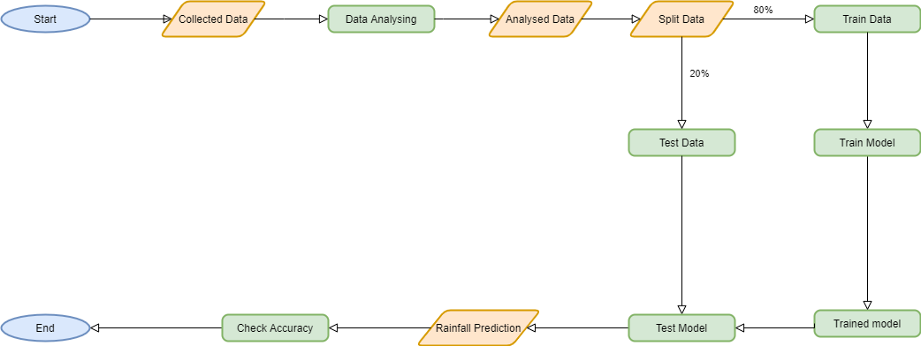
RESEARCH METHODLOGY TRAINING PROCESS

Slide 56
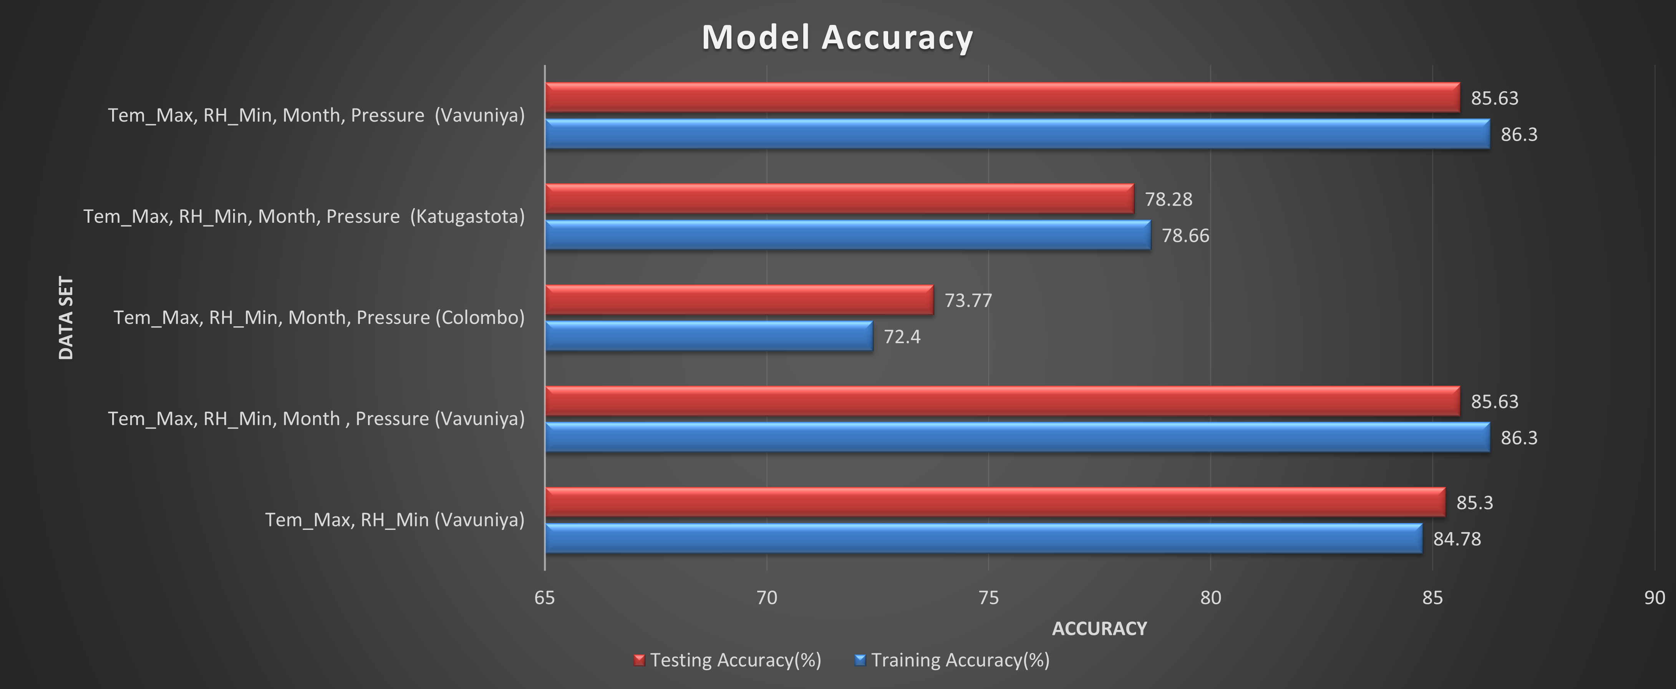
RESEARCH RESULTS Training Logistic regression( Daily Data) (Achievement)

Slide 57
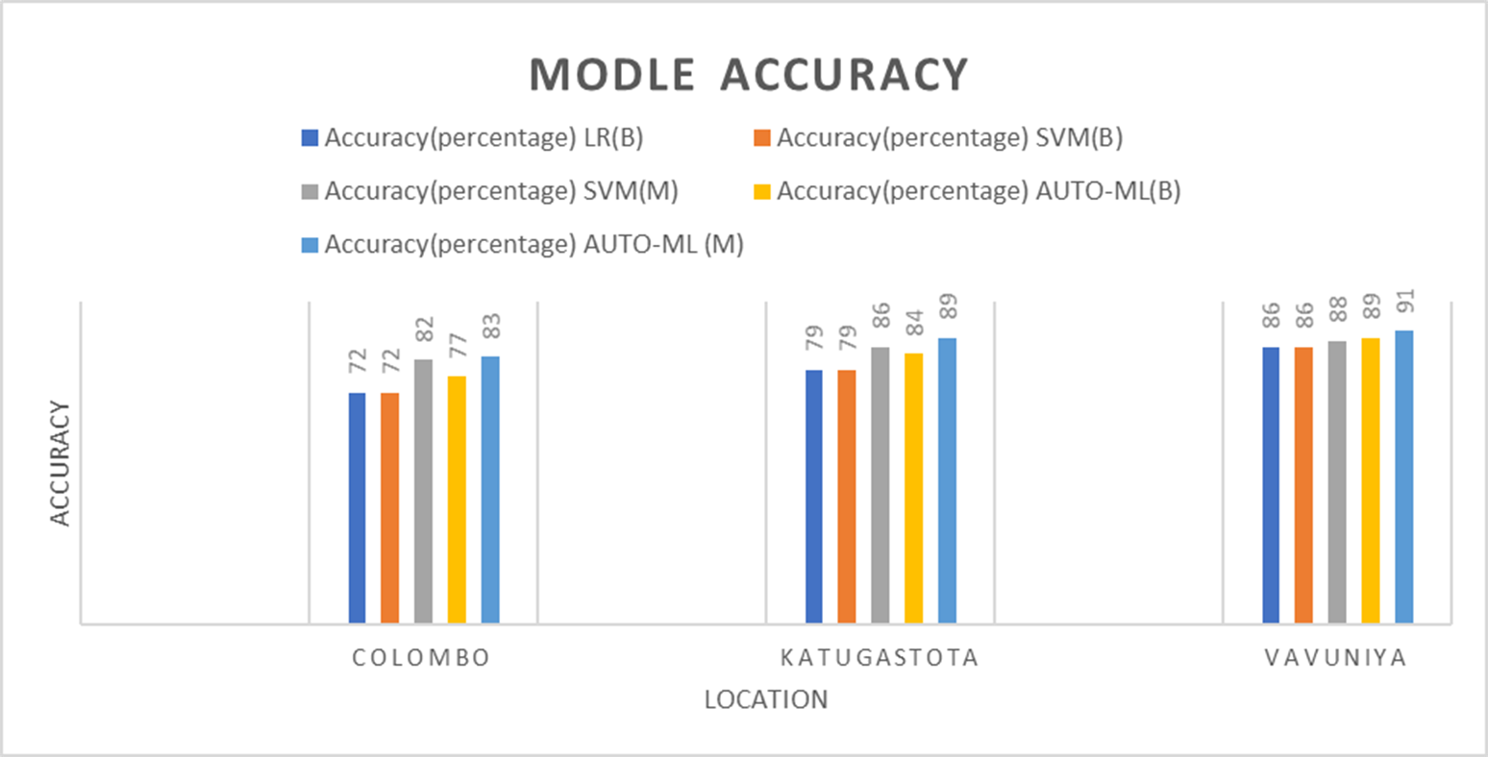
RESEARCH RESULTS

Slide 58
Prediction Process

Slide 59
RESEARCH METHODLOGY FINDINGS
The contribution of temperature and relative humidity is higher in causing rainfall.
Contribution of the attribute ”month” can be considered while using specific locations.
The Vavuniya and Katugastota models give better accuracy than the Colombo model.

Slide 60
Demo

Slide 61
Thank You!

